Slide 1
Promoting Health Sciences Librarianship in an Information Changing World
Michelle Kraft, MLS, AHIP, FMLA
Director, Cleveland Clinic Libraries
April 17, 2024 MDMLG Meeting
Notes:
the ever-evolving landscape of information, health sciences librarianship plays a pivotal role in guiding the public and professionals through a sea of data. As gatekeepers of knowledge, librarians are uniquely positioned to combat misinformation and leverage artificial intelligence (AI) to enhance library services.

Slide 2
Information seems to have “changed”
Fake news debate
Is it fake or is it real – how do we know
AI and full text information as data
Once owned, now lease, future?
Barriers – same but different
Access more of a mess
OA and pre-print – good, bad, ugly

Slide 3
What can we do?
Education
Manage and promote digital & physical collections
Advocate & collaborate
Experiment and share

Slide 4
Fake News
Government
Organizational
Personal
Notes:
Fake news has been around forever:
Our founding fathers were fakers of news:
1769 John Adams wrote in his diary about spending the evening “Cooking up paragraphs, articles, occurrences, - working the political engine” planting false and exaggerated stories meant to undermine British rule
William Livingston (Governor of New Jersey) covertly fake news articles that were published in news papers to draw resentment against crown. An article of his in “The Impartial Chronicle” claimed the king was sending tens of thousand of feign soldiers to kill Americans.
During WW2 British Air Ministry didn’t want the Germany government to know that they had a new fangled technology that helped them shoot down enemy aircraft. That technology was RADAR and the British were using it intercept bombers on night raids. So they issued press releases stating British pilots were eating lots of carrots to give them exceptional night vision. There are tales that the Germans started feeding their own pilots carrots. Whether or not this is true, the British government doubled down it and British public seemed to buy it. In addition to government press releases, advertisements to plant and eat carrots so people could see during the blackouts proliferated throughout the war.
Its is also in current health care policy.

Slide 5
Is it real or fake?
Notes:
It is getting harder and harder to determine fake news. While there are many different people and organizations that put out fake news there are different types of fake news.
Deceptive – Completely made up, not truth. Imposter sites, designed to look real. – Could be predatory journals
Misleading – Promote an agenda with teeny tiny factual info and spin it. – intended to “rile up people”
Slanted/Biased – Contains truthful information but certain facts are chosen or omitted to serve an agenda – Not necessarily false stories but reported in a biased way (Both political parties and news organizations on the left and right)
Manipulated - Content that is altered typically we think of photos (Trump’s inauguration crowd size. Ukraine “Ghost of Kyiv”
Could manipulated be AI
Humor – satire – The Onion

Slide 6
Another Venn Diagram
Misinformation = False content that is unintentionally or unknowingly disseminated.
Disinformation = False content that is intentionally disseminated with intent to harm.
Malinformation = Genuine content that is intentionally disseminated with intent to harm.
Information disorder: 'The techniques we saw in 2016 have evolved' (firstdraftnews.org)
https://firstdraftnews.org/articles/information-disorder-the-techniques-we-saw-in-2016-have-evolved/

Slide 7
Healthcare Policy
DECODING THE MISINFORMATION-LEGISLATION PIPELINE:
AN ANALYSIS OF FLORIDA MEDICAID AND THE
CURRENT STATE OF TRANSGENDER HEALTHCARE
Lockmiller, C. Decoding the misinformation-legislation pipeline: An analysis of Florida Medicaid and the current state of transgender healthcare. JMLA. October 2023. Vol.111(4); https://doi.org/10.5195/jmla.2023.1724
Notes:
We know how misinformation spread like wild fire with COVID and vaccines. But misinformation is being passed along as real and utilized to impact legislation.
The Florida Department of Health utilized non-scholarly research and opinion pieces to issue health care policy for LGBTQ+ healthcare against all of the policies and statements written and created by the experts at
American Academy of Pediatrics (AAP)
American Academy of Family Physicians (AAFP)
American Medical Association (AMA)
Endocrine Society
World Professional Association for Transgender Health (WPATH)

Slide 8
Fake news, the weeds of information
Its hard to spot
Can look nice
Spreads quickly
Hard to eliminate

Slide 9
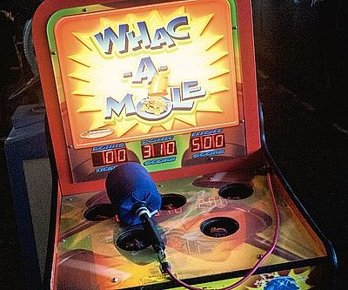
Difficulties
Push back
Once it is out, it is out
Notes:
Debunk
Debiasing
Prebunk/Inoculation
Debunking is extremely difficult for many reasons. The biggest is people generally don’t like being told what to think and how to act so there is a natural resistance to anyone doing so.
Remember way back when I talked about self image, people endorse or support information that matches their preexisting beliefs or comes from ideological aligned source. When you are contradicting those preexisting beliefs you are contracting a part of their sense of self, their community, their being.
We see this very strongly with the anti-vax movement. They are a part of a whole community where their world view includes the dangers of vaccines. I am sure some of you have encountered friends and family who no matter what information you provide to debunk the idea that vaccines are bad, they dig in even more.
In the Journal of Applied Social Psychology, the author found that exposure to belief threatening evidence will lead people to discount the entire scientific method. People would rather believe the issue cannot be solved scientifically rather than discounting scientific evidence that goes against their beliefs.
As I mentioned fake news, misinformation spreads faster than legitimate information. As it spreads it repeated. Repeated information becomes familiar and then legitimized in a person’s mind.
A well documented example of this is mistaken belief that Listerine mouthwash can help prevent or reduce the severity of cods and sore throats.
Listerine had made these claims for 50 yrs and recounted them after the US Federal Trade Commission mandated their correct their advertising. Between 1978 and 190 Listerine ran ad campaigns retracting the cold and sore throat claims. They spend $10 million yet were only moderately successful. In 1983 a telephone survey revealed 42% of Listerine users still believed in it therapeutic effects and 57% of those people bought it for those “medicinal reasons.”
Credibility can backfire or boomerang.
On the AAMC’s website there is an article, “Why do people believe medical misinformation?” The article describes a pregnant woman who was a quality control chemist at a pharmaceutical plant .She got the flu shot when she was pregnant but when her child turned 2 months she found the credible medical community dismissive of her concerns. After the shots her baby cried and was uninterested in nursing for 2 days. She was anxious (emotions) and when she turned to the public health nurse for help she felt “brushed off.” She described it as “We know what’s best and if you want your baby to live then you better do what we say.” But when she was struggling, the doctor didn’t know what was best, he offered no practical advice and said “if it doesn’t work out, don’t be so broken up about it.” She said those encounters left her feeling down, dismissed, and loss of trust which she said opened the door for her doubt the credibility of medical professionals. She turned to the internet an found a mother’s forum where she found people encountering the same thing. She eventually stopped getting shots for her baby and subsequent children. People trust human information if it is similar to themselves (from their bubble) and the nurse and doctor did nothing to be similar to her.
The problem with fake news is that not only that people fall for it but it also erodes trust in legitimate news and the credibility of experts. Which is what you see with people questioning covid vaccines, climate change, reasons to go to war, GMOs, etc. This leads to a backfire or boomerang effect. People implicitly counter argue against any information that challenges their world view no matter the credibility.

Slide 10
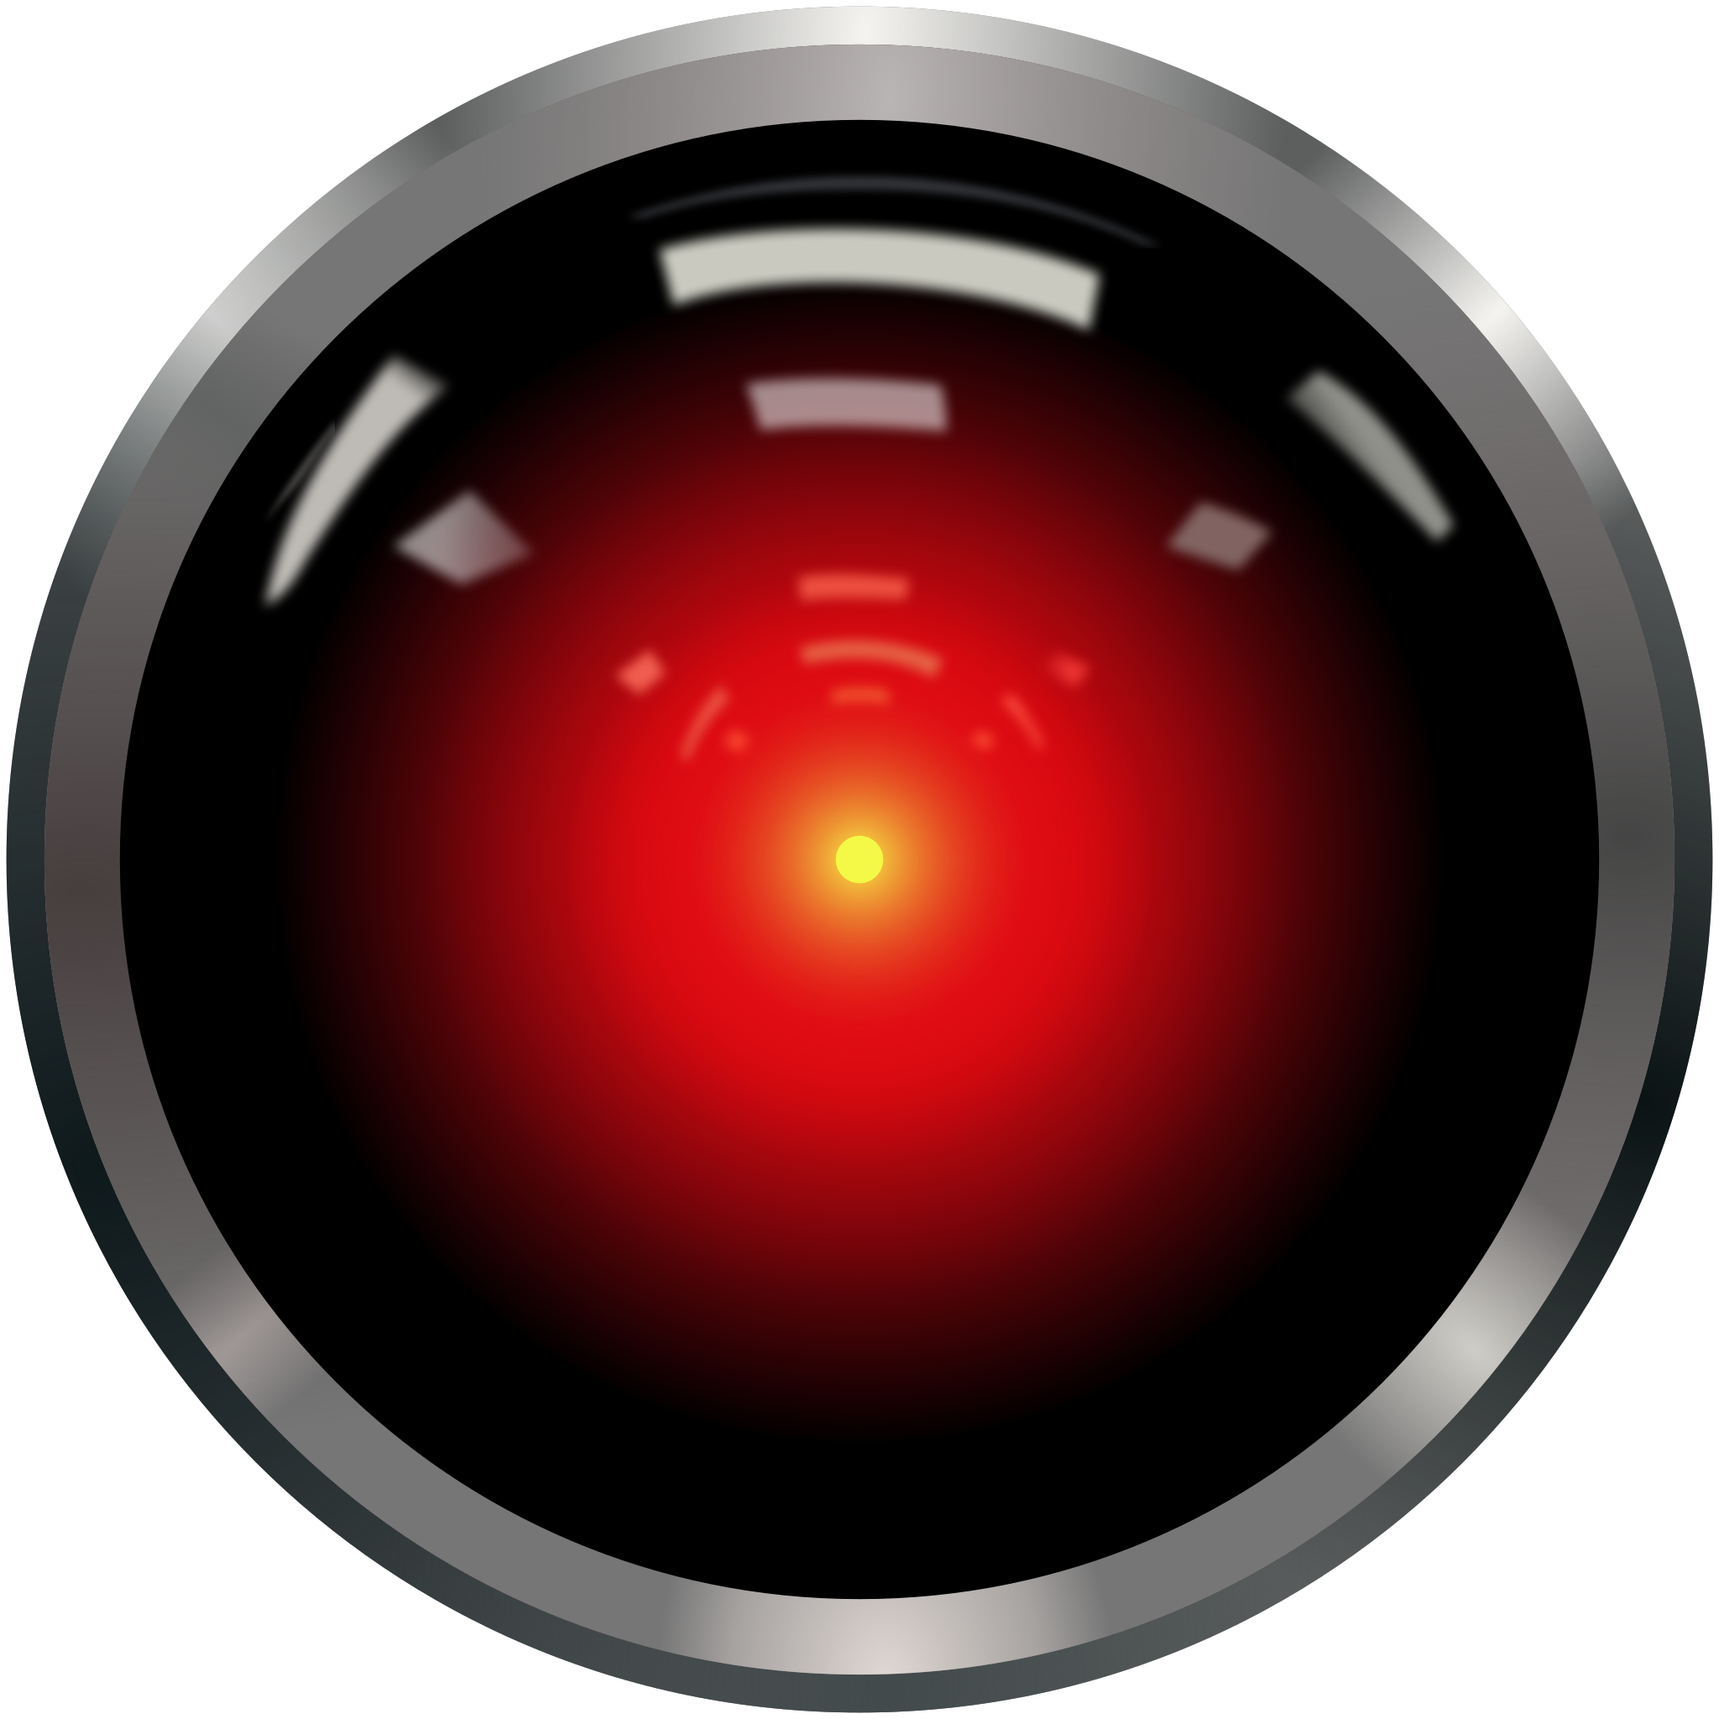
AI and Information
What does this mean for librarians and the people we serve
Collections?
Databases?
Access?
Notes:
So not only is harder to determine what news/information is fake… we have an added layer complicating things. AI
Not all AI is HAL
However, all AI uses/information data to provide answers so if the data is bad/fake then the answers are suspect.
What does it mean for legit news that isn’t easily found online or is incomplete (behind paywalls, in A&I databases, in a different format)
What will be the costs of full text AI databases?

Slide 11
Barriers to Information
J Med Libr Assoc. 2021 Jan 1; 109(1): 126–132. Published online 2021 Jan 1. doi: 10.5195/jmla.2021.1051
Notes:
Description of 8 pain points that users experience when they try to access information in a clinical environment from MLA’s Insight Initiative on barriers to clinical information access.
Can AI help with this? How does fake news exploit these pain points?

Slide 12
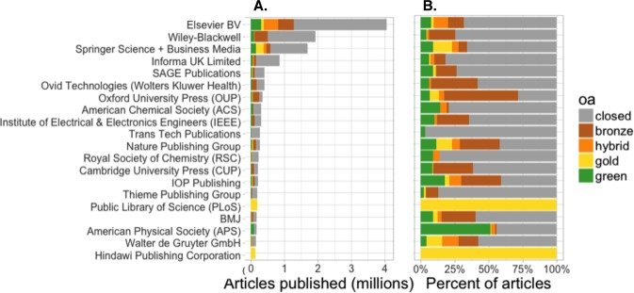
OA will not solve access to info
Approximately only 28% of DOI assigned articles are OA (2018)
Much of OA is federally funded research articles
Review articles, editorials, clinical pearls, instruction articles are typically not OA
PeerJ. 2018; 6: e4375.
Published online 2018 Feb 13. doi: 10.7717/peerj.4375
Notes:
Piwowar H, Priem J, Larivière V, Alperin JP, Matthias L, Norlander B, et al. The state of OA: a large-scale analysis of the prevalence and impact of Open Access articles. PeerJ. 2018;6:e4375–e.
DOI is the digital object identifier. It’s a string of numbers and letter to provide a permanent URL to an article. Theoretically is more stable than the URL. Introduced in the late 1990’s was was first standardized in 2000 and final standardization came in 2012.

Slide 13
Percentage of different by discipline
PeerJ. 2018; 6: e4375.
Published online 2018 Feb 13. doi: 10.7717/peerj.4375
Notes:
So with still a majority of the medical information behind pay walls how are we to utilize AI to help with finding information?

Slide 14
Promoting ourselves now and future
Notes:
Education
Manage and promote digital & physical collections
Advocate
Experiment and share

Slide 15
Education
Notes:
We must educate ourselves on fake news and AI to better understand how to educate users and patrons
- Experimentation, CE, Articles, Podcasts, etc.
- Educate ourselves on options to help prevent or debunk fake news
- Spread our knowledge and help educate others outside of the library – GET OUT THERE

Slide 16
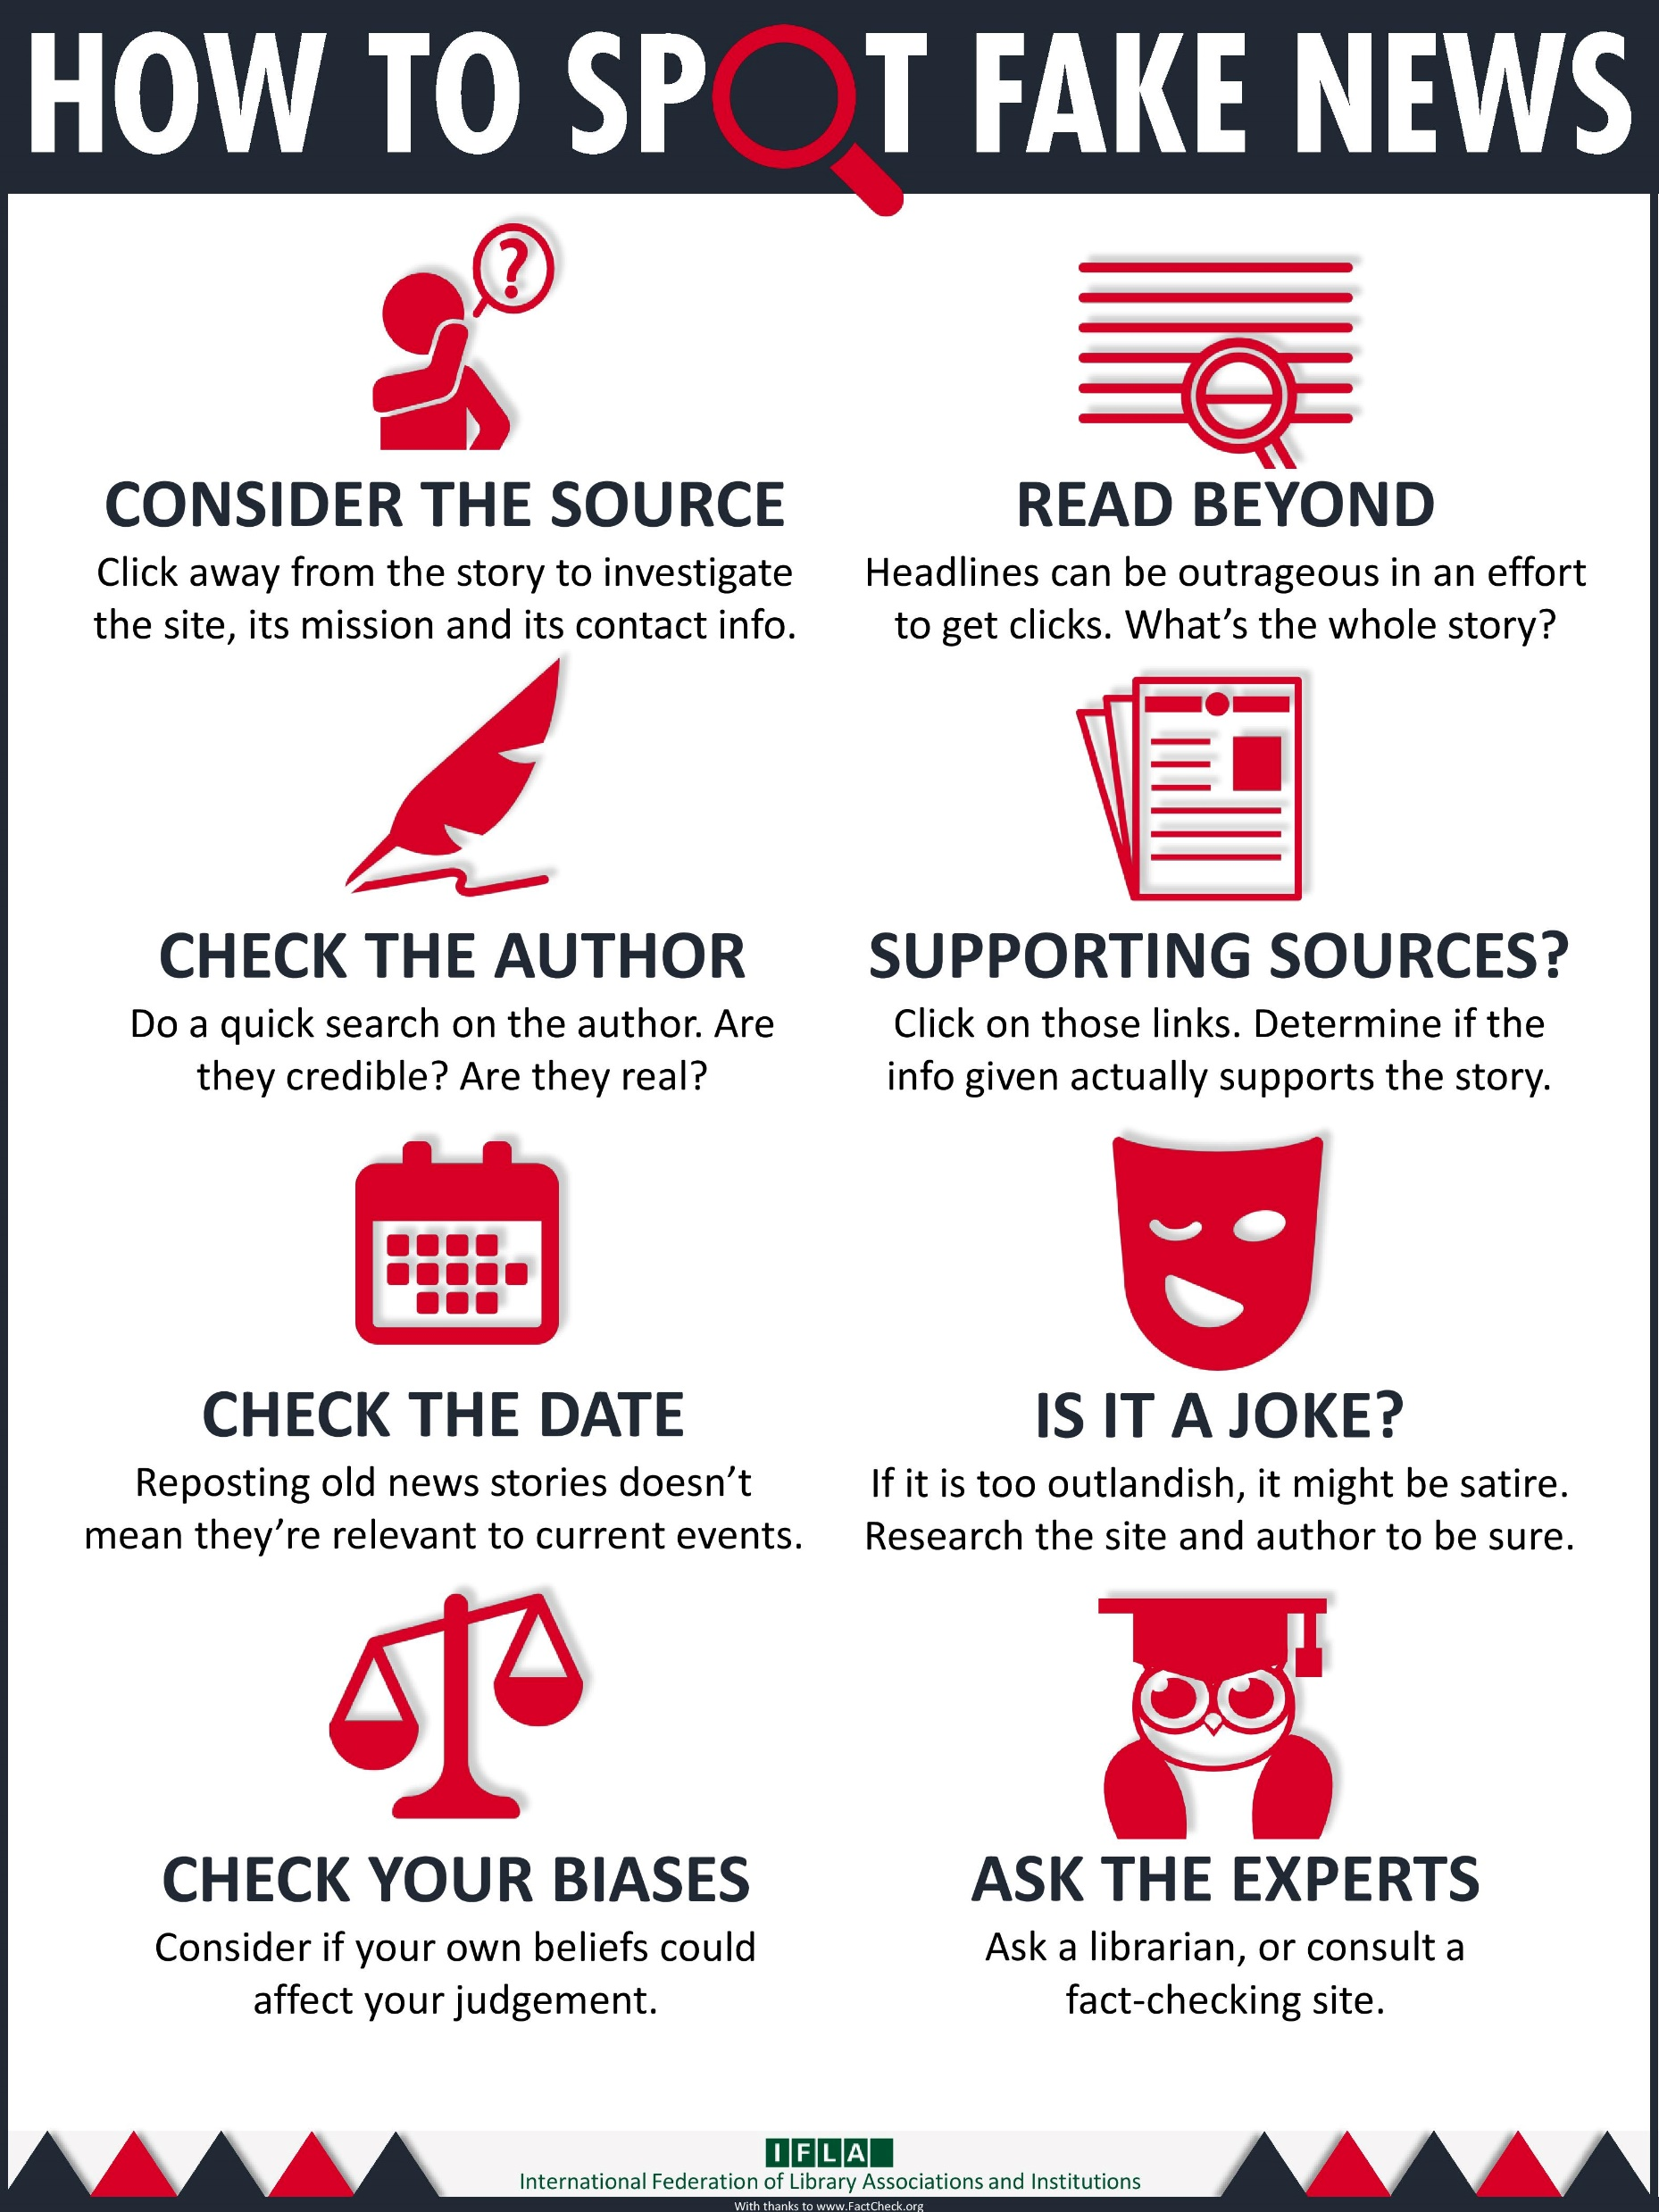
Fake News Tools
Online Games – Bad News
https://www.getbadnews.com/
Website aids – Media Literacy Guides
Links to go to good sources
https://libguides.uvic.ca/fakenews/health-misinformation
https://becker.wustl.edu/news/resources-to-fight-covid-19-misinformation/
https://wamc-amedd.libguides.com/medicallibrary/patienthealth
CRAAP tool
Links to basic articles on stopping the spread
Information to help clinicians
Notes:
We need to arm ourselves and the people we serve with tools to help counter fake news.
People tend to remember or learn things when they are active participants. Bad News is a game that takes you through how to be the best at dolling out fake news. First Draft News mentioned earlier has tools we can use.
Website aids – library web pages, linking to good sources to contradict fake news, & visual aids on spotting fake news.
CRAAP stands for Currency, Relevance, Authority, Accuracy, and Purpose. PURPOSE – WHY does it exist
Some academic libraries have sites as well as some public. But we who talk about how to evaluate journals for publication, how to find information for consumers, generally did not have web pages from medical libraries on how to help address and spot fake news.
We have tons of pages on misinformation on covid. But that is just one drop in the medical fake news bucket.
Simple articles on how to stop the spread.
Information for clinicians as to how they talk to patients.
In a post from October 2022, The AMA president discussed how he hears from frustrated physicians dealing with patients that they have seen for years and trusted their care, make decisions against their medical advice based on fake news.

Slide 17
AI Tools
Temple University LibGuide https://guides.temple.edu/ai-chatbots
Rubrics https://blog.tcea.org/rubric-checklist-assessing-ai-tools/
Learn Prompting https://learnprompting.org/
University of Arizona Generative AI – student guide & instructor guide https://libguides.library.arizona.edu/genAI/guides
Notes:
Temple has a good libguide
Use Rubrics to assess AI systems
Learn how to search Generative AI

Slide 18
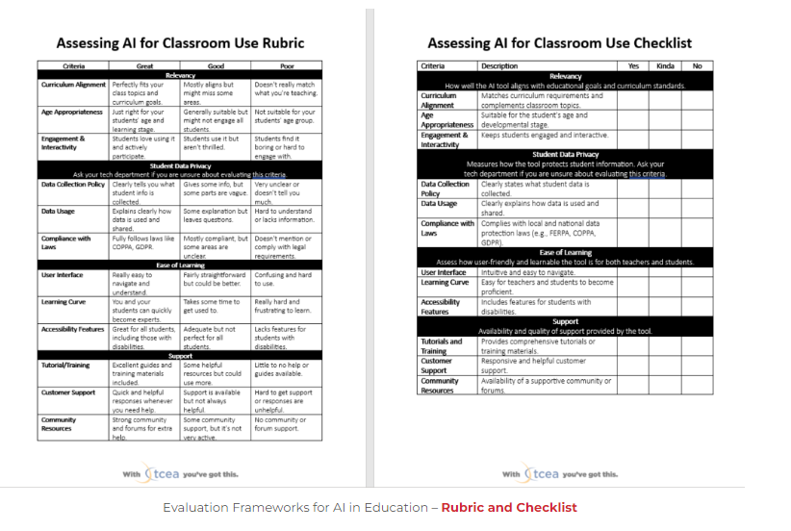
A Teacher Rubric and Checklist for Assessing AI Tools • TechNotes Blog (tcea.org)
https://blog.tcea.org/rubric-checklist-assessing-ai-tools/

Slide 19
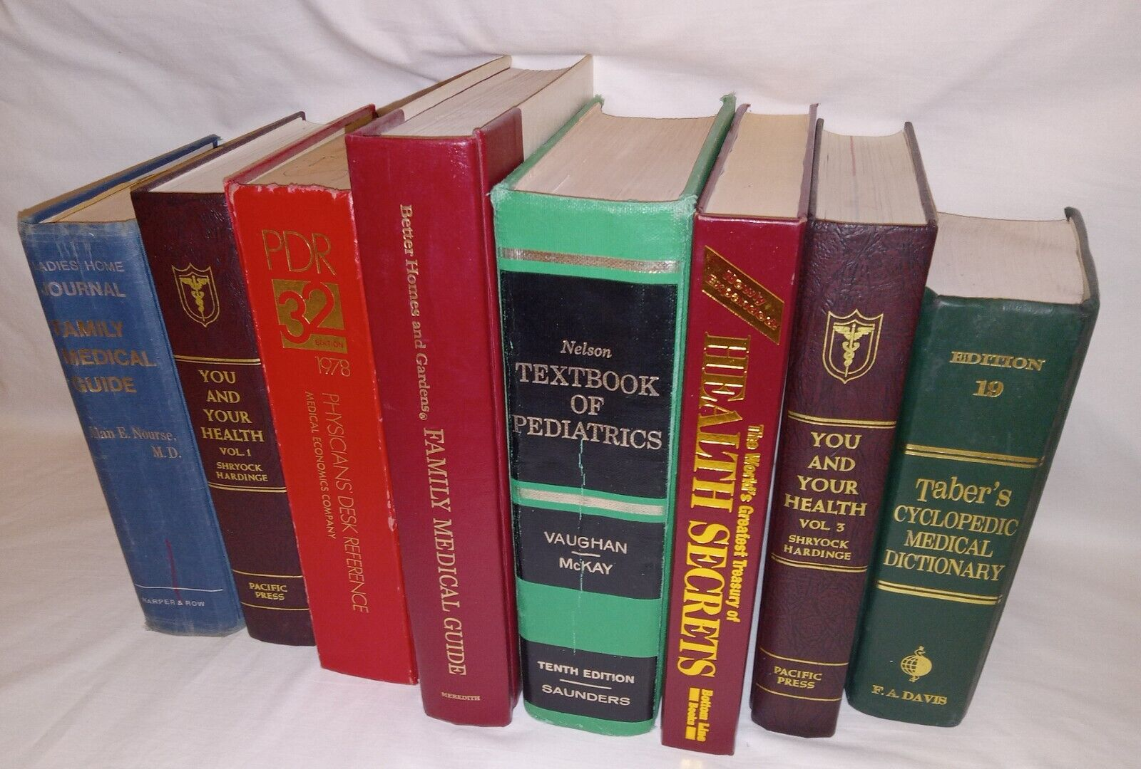
Collection
Why do we have it?!
Natural Cures "They" Don't Want You to Know About
18 editions in 2,103 libraries
Old information on the shelves
Why use it online?!
Predatory journals
Retractions
Preprint–use caution
Notes:
This book which I am not going to say the title was written by a convicted felon for fraud and larceny.
Has been found in contempt of court for making deceptive claims about his books & fined more than $5 million and banned from infomercials for 3 yr regarding fraudulent claims for his book.
Yet this book and others like written by him are in academic & medical libraries. Including NLM. Why?!
There are older books that exist (not that old) that refer to certain sexual health things as mental disorders.
In an article from Collection Management 1985
“value of weeding lies primarily in developing a quality collection by eliminating out-of-date information that is potentially misleading and, in areas such as medicine, even dangerous”
Yet we seem to struggle with this. In a 2002 JMLA article the author states, “Despite valid reasons for weeding, some librarians may be reluctant to weed due to possible repercussions from administration, faculty, or the community when large numbers of books are discarded.”
Some information in predatory journals may be good, but we don’t know. It hasn’t gone through vetting that articles within established journals have gone through.
Just look at the damage the fake research article on vaccines has done to society. That was an article in a legit journal. Peer review didn’t catch it.
Yes peer review has problems, but predatory journals have zero guard rails for vetting information.
We need to be more vigilant about educating people and we push for ways to identify these items so they are not mixed in with research published in legit journals.
We need to pay more attention to retractions and call attention them.
Retraction Watch, PubMed, BrowZine
PLOS ONE found that nearly half of the preprint articles found on medRxiv that were published in peer reviewed journals contained differences in data, title and some had different conclusions. Those with different titles makes it difficult to verify the information with the published peer review information.
While the old stuff had been informationally correct, it may no longer be so and can be used in misinformation.
Unvetted information may not have ever been correct. For example the flawed ivermectin preprint article fueled the interest in the drug to fight covid.
Before that article was withdrawn from the preprint servicer, it was viewed more than 150,000 times and cited 30 times. Including a meta-analysis in the American Journal of Therapeutics that found ivermectin greatly reduced covid-19 deaths.

Slide 20
Advocate & Collaborate

Slide 21
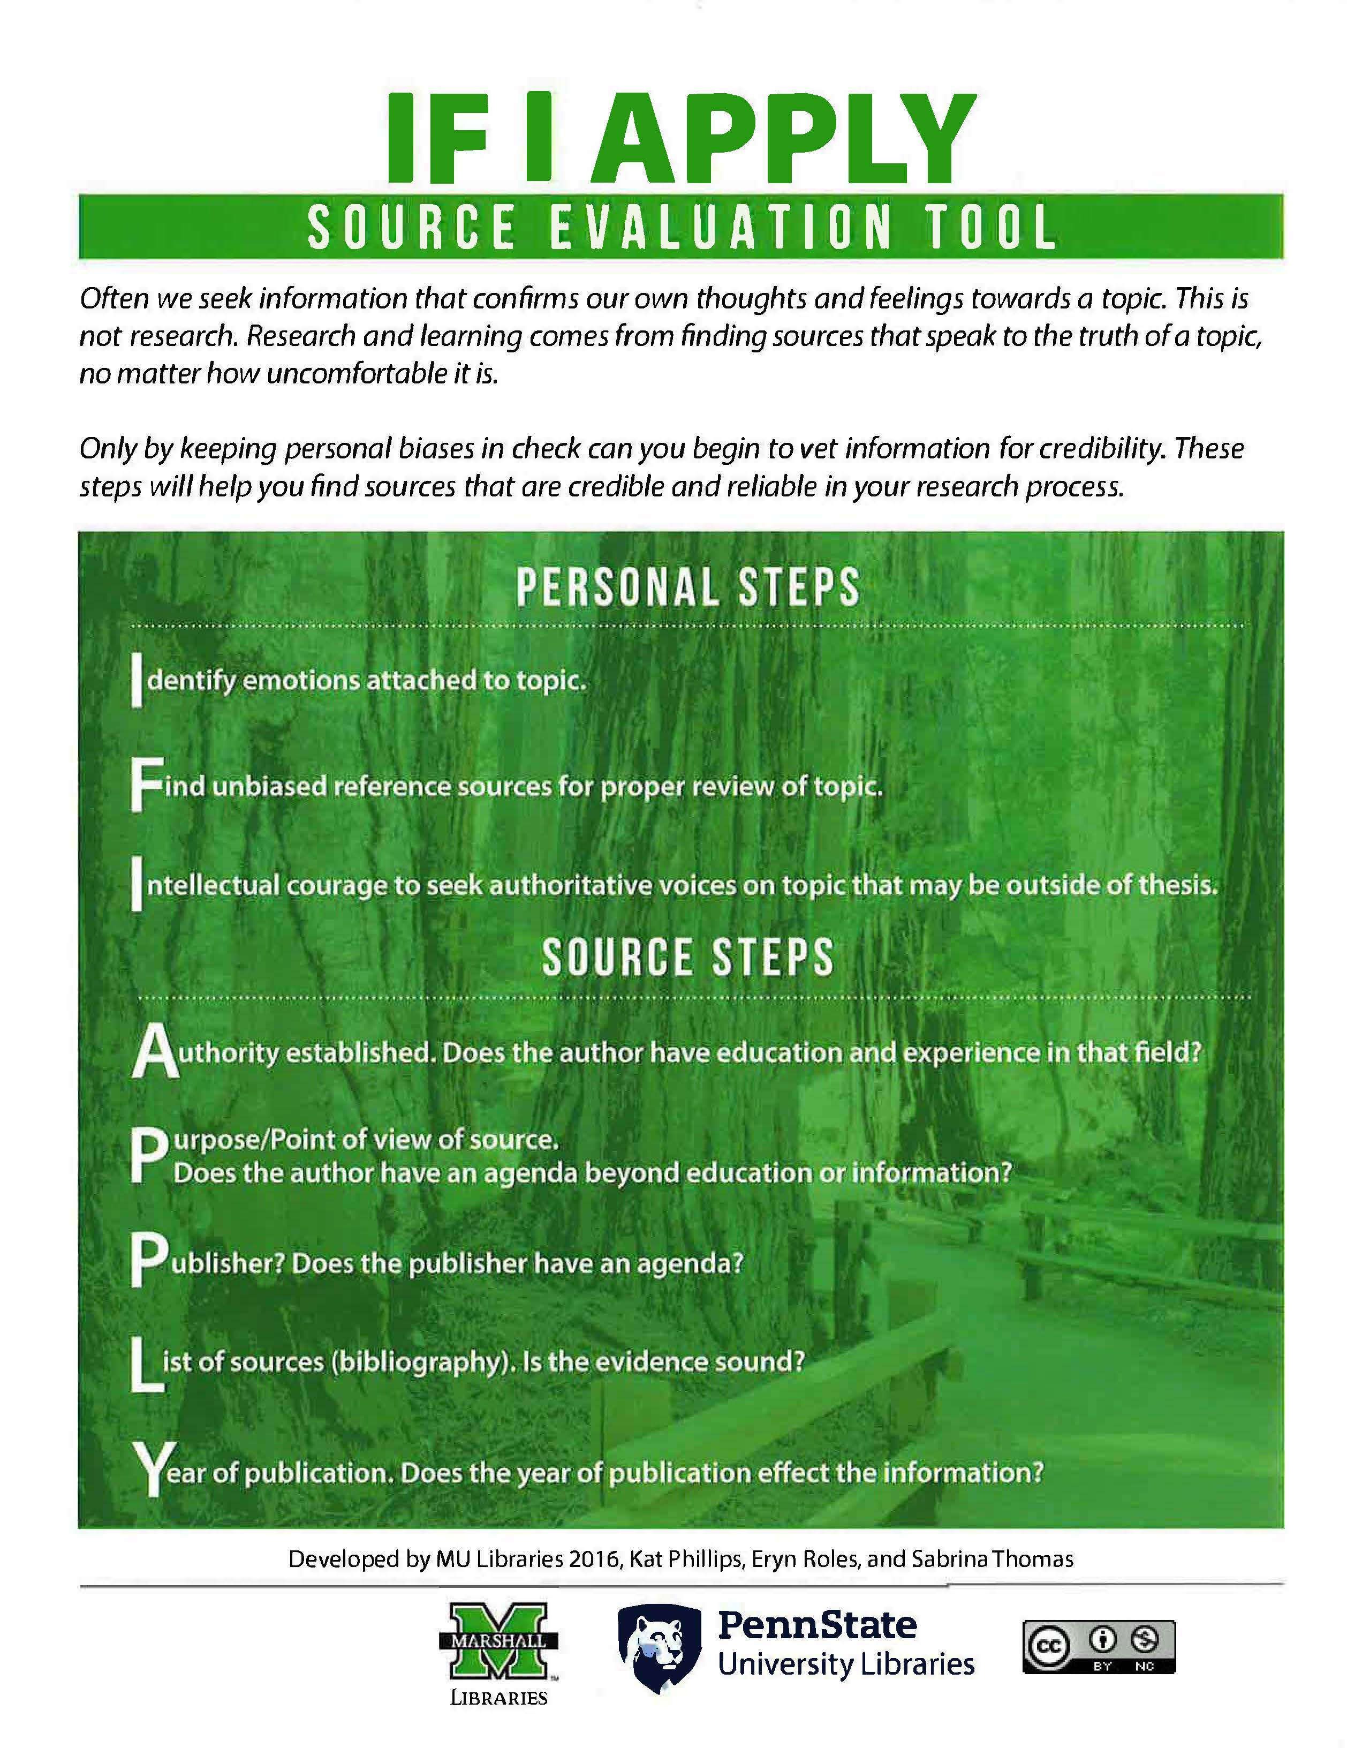
Education & Collaboration
Partnerships
Public libraries
Journalism schools
Schools of public health
Media & Information literacy
Reflect the digital landscape
Correlation vs. causation
Lateral reading
Notes:
Fake news is an everyone problem. Yes I am a medical librarian, but there is nothing stopping all librarians partnering together and from involving non librarians to help.
I think sometimes it is really tricky for non-medical librarians to know they can provide medical research information. – Going to library school 3 areas you don’t touch: Legal, Taxes/Financial, and Medical.
Library schools need to cut that out… It should do not give legal ADVICE, taxes/financial ADVICE or medical ADVICE.
“Here is some health/medical information I found. Take a look at it and consult with your doctor or nurse about your options.”
Journalism schools have identified fake news as problem within the industry. Public Health relies upon communicating information to communities and is particularly impacted by fake news.
These areas of scholarship w/n our universities and colleges are natural areas for partnerships.
Media literacy - lens through which to view the world and express oneself, while information literacy sees information as a tool with which to act on the world
Much of our information literacy focuses on the sources, not the person reading the information. Because we tend to believe information that speaks to our own world view, we need to remember when we are teaching and acknowledge people are coming at information from their personal world view. Which is not something we often think about when teaching information literacy but is a part of media literacy.
IF I APPLY is an example of a source evaluation tool that mentions this. The first 3 parts of this tool looks at the person consuming the information which is more a reflection of the digital information landscape.
In the Journal of Academic Librarianship authors state we need to empower students to use tools to assess information and it specifically mentioned they need to understand the difference b/n correlation and causation.
Most people have a big problem understanding correlation, causation, and coincidence. This often gets exploited by fake news outlets. People are ok with simple things. For example:
A large population of men over 6’4” play in the NBA.
It would be wrong to say playing in the NBA CAUSES you to grow to be at least 6’4”
There is a CORRELATION to tall people being in the NBA.
Also being tall does not CAUSE you to be good at basketball, but someone who is tall might try playing and there is a CHANCE that they might be good at it.
It gets way more difficult to understand the differences when we are looking at complicated biomedical or scientific concepts and terms….which fake news exploits this difficulty.
Lateral reading…instead of checking its listed sources it is leaving the site and checking the facts mentioned from multiple sources. Info about the author (if listed) check what other say about them. Understanding where the information from lateral sites is from to understand the validity of the information.
At the 2018 MLA InSight, participants mention Information literacy training should encompass social media so authors can responsibly counter misleading or harmful tweets about their work
We also have to get around the idea of Information Literacy on how our patrons find information. It is not just about how to search and cite.
Information literacy is also how view, evaluate, interpret, and spread information…Are we going to be the dandelions of fake news or accurate information?

Slide 22
Experiment & Share
Try AI –not all AI’s are the same!
Searching
ChatGPT 4 via Bing (Copilot), Perplexity
ResearchRabbit, Undermind.ai
Scopus AI (2018-P), ClinicalKey AI
Distiller, Covidence, etc.
Life Hacks
Emails, letters of recommendation, translation
Education
Critical thinking opportunities
SciSpace https://typeset.io/
Notes:
Perplexity - https://garymarcus.substack.com/p/serious-medical-error-from-perplexitys?r=iu073&triedRedirect=true
ResearchRabbit - citation chasing literature mapping and visualization tool. Searches a very large literature corpus covering >90% of academic databases, plus grey literature. Start with uploaded citations, or link to Zotero citation manager.
A "deep search" tool with a substantial free tier. Takes a verbose user prompt and searches over titles and abstracts in Semantic Scholar. Runs multiple searches and learns from the results, yielding more comprehensive and accurate literature than many other tools. The company's own benchmarking claims to find it better than Google Scholar. Details in their whitepaper.
Scopus AI - https://scholarlykitchen.sspnet.org/2024/02/21/guest-post-there-is-more-to-reliable-chatbots-than-providing-scientific-references-the-case-of-scopusai/
Rubrics - Rubrics — AI for Education

Slide 23
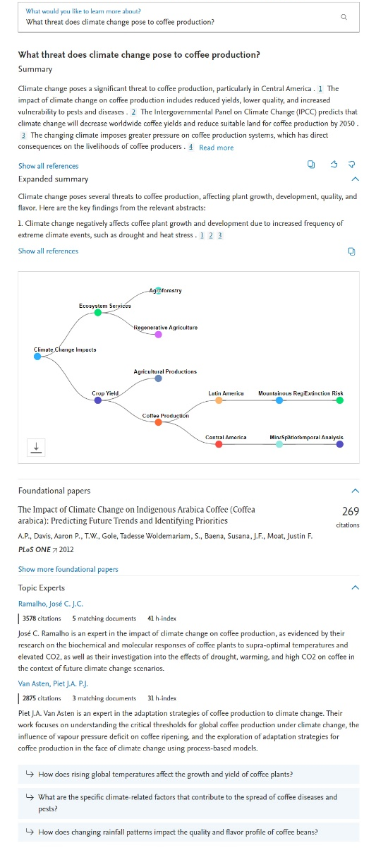
Scopus AI
Natural language queries
Ease your search: Ask questions about a subject in a natural, conversational manner.
Summary with Scopus references
Instant overview: Skip the lengthy reading. Read a concise and trustworthy summary with academic references for each search. Dig deeper with expanded summaries.
Visual representation of entities
See the big picture: View a graphical representation of the keywords to reveal hidden connections and insights.
Foundational papers
Discover influential papers. Rapidly pinpoint seminal works, navigating academic progress and impact with precision and ease.
Academic Expert Search
See who the experts are. Rapidly identify the leading authors based on your query alongside explanations of their relevant expertise.
Deeper query exploration
Uncover more: Explore beyond the surface. Our AI offers relevant queries to discover new perspectives.
*Interface and functionality subject to change
Notes:
Here are the main features of Scopus AI. Natural language queries let you pose questions in a natural, conversational manner. Summaries with Scopus references give you a concise and trustworthy summary with citations, so you can see where the claims come from. Visual representations map out search results so you can see all the links between different subjects. The Foundational papers option lists the most high-impact Scopus papers on any topic and Topic experts displays the top researchers linked to your query. The 'Go deeper' questions will prompt new questions, helping you drill down and broaden your understanding.
In the next few slides, we’ll look at each of these features.

Slide 24
Slide Help

Slide 25
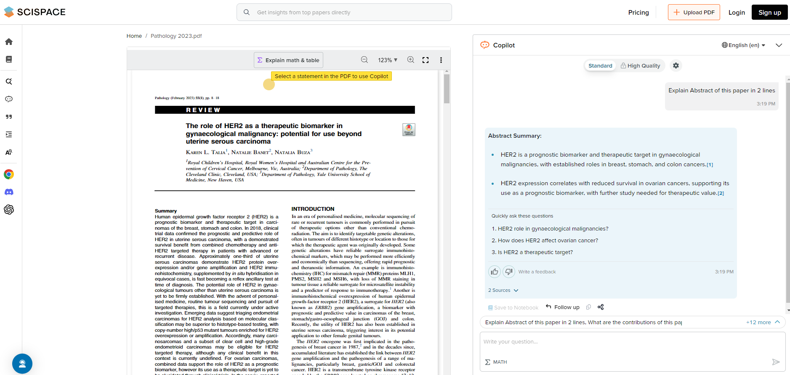
Notes:
Explain Abstract in 2 lines
What are the contributions
Find Related Papers
Explain practical implications of this paper
Summarize the intro
Literature survey of this paper
Method used in this paper
What data has been used
Results & Conclusions
Limitations of this paper
Future works suggested

Slide 26
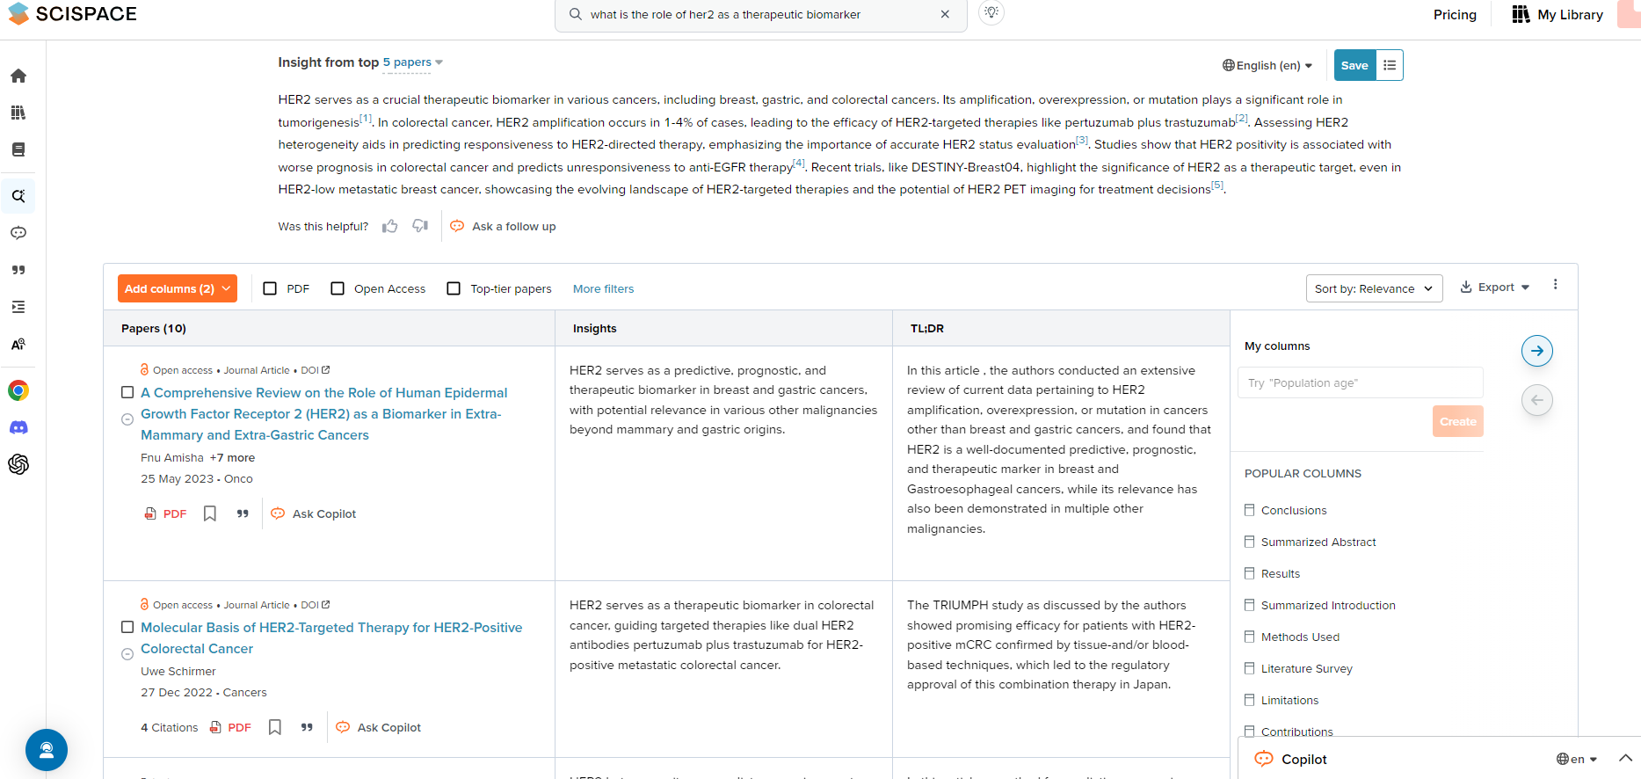

Slide 27
Keep Playing

Slide 28
Librarianship is a Team Sport

Slide 29
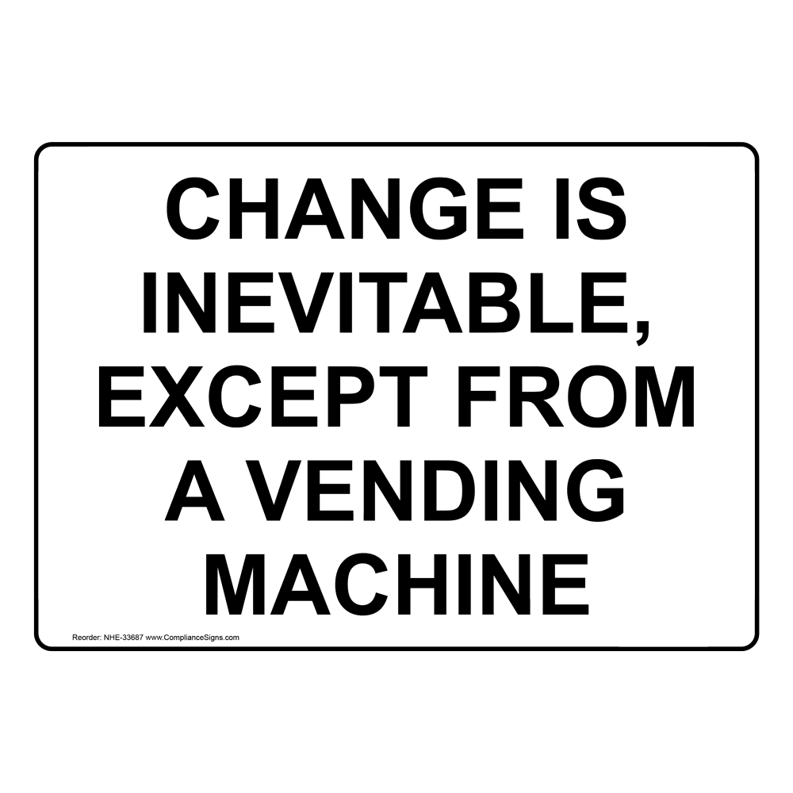
Questions?
kraftm@ccf.org

